Slide 1
Jaringan Komputer
Pertemuan 3

Slide 2
IP Address

Slide 3
Sebuah sistem pengalamatan setiap host (PC/Switch/Router) yang terkoneksi dalam jaringan
IP Address = sebuah alamat/identitas rumah
IP Address bersifat unik (berbeda satu dan lainnya)

Slide 4
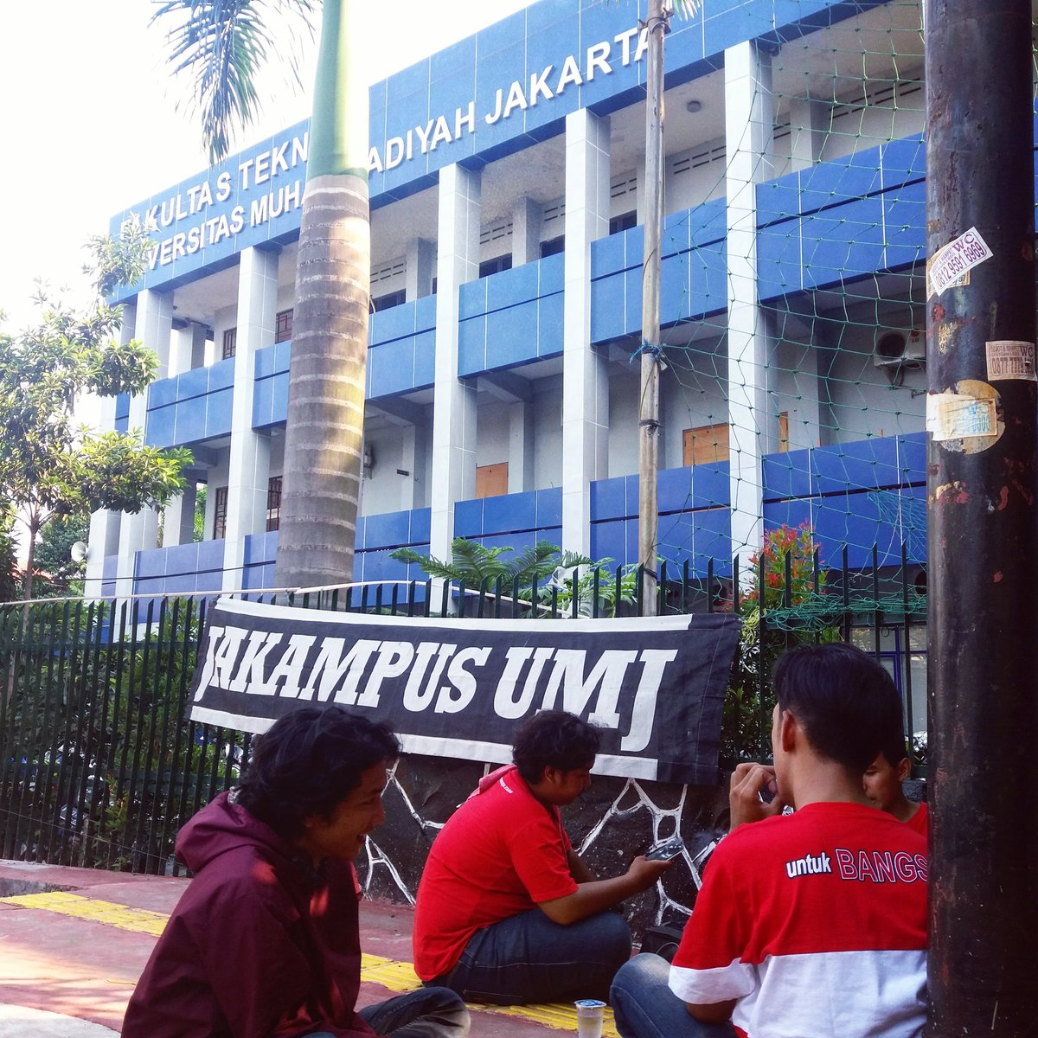
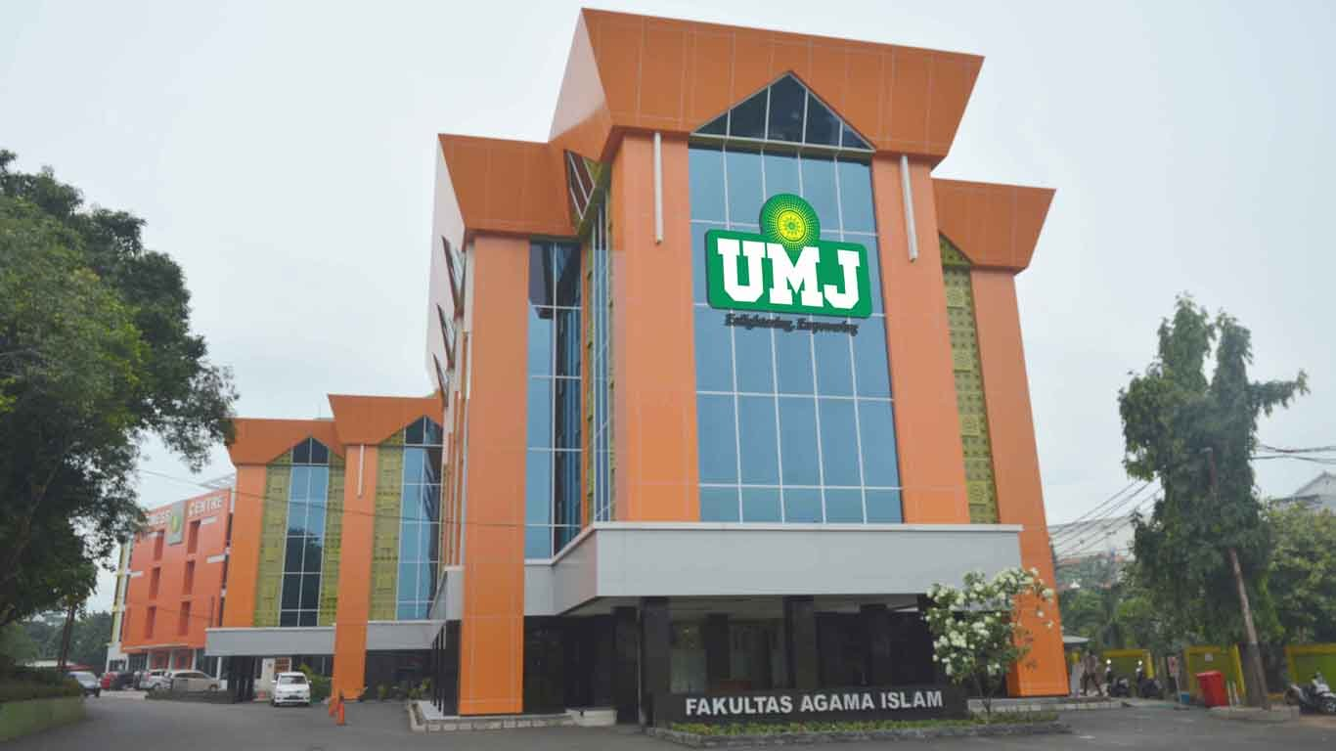
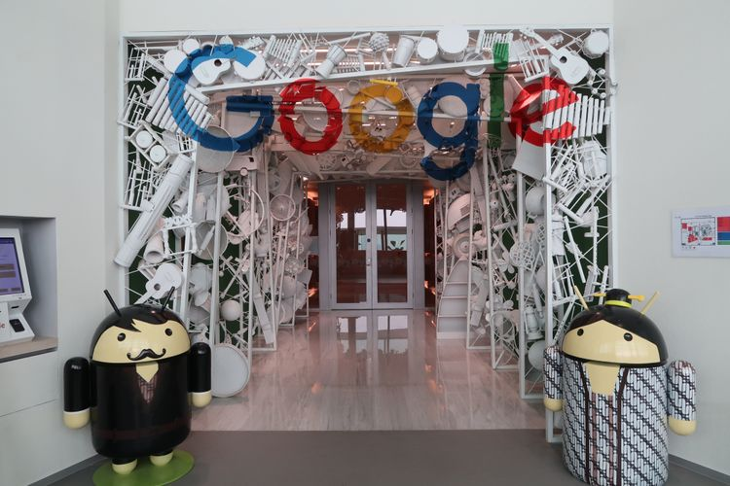
IP Address = Alamat
Jl. Cempaka, No.1
Jl. Ciputat, No.2
Jl.Raya, No.3

Slide 5
IP Address Bersifat Unik
Jl. Tikus, No.1
Jl. Tikus, No.1
Jl.Tikus, No.1

Slide 6
IP Address terdiri dari 4 oktet, nilai tiap oktet = 0 sd 255
0.0.0.0
172.16.254.1
195.2.1.2
255.255.255.255

Slide 7
Jenis IP Address

Slide 8
IP Public (jaringan internet)
IP Private (jaringan lokal/pribadi)
IP Khusus:
Self identification 0.0.0.0 /8
Localhost 127.0.0.1
DHCP error 169.254.0.0 /16
Multicast 224.0.0.0 /4
Limited broadcast 255.255.255.255 /32

Slide 9

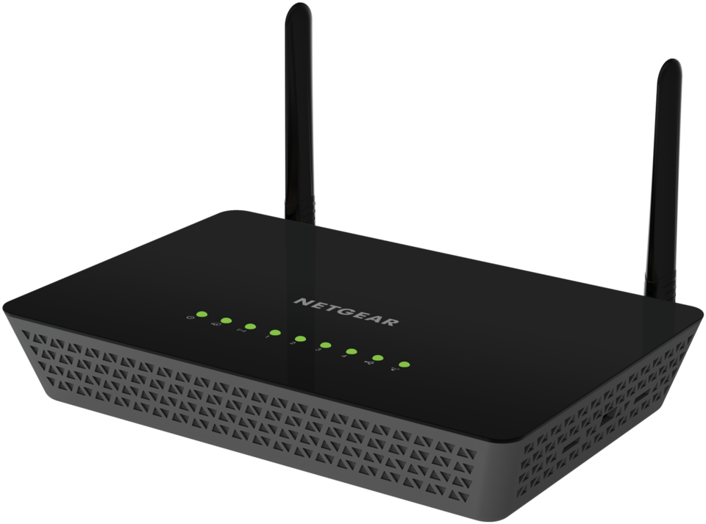
IP Private
Router
IP Public

Slide 10
Kelas IP Address

Slide 11
KELAS | RANGE IP ADDRESS | JUMLAH HOST | JUMLAH NETWORK
A | 0.0.0.0 – 127.255.255.255 | 16.777.216 | 128
B | 128.0.0.0 – 191.255.255.255 | 1.048.576 | 16.384
C | 192.0.0.0 – 223.255.255.255 | 65.536 | 2.097.152
D | 224.0.0.0 – 239.255.255.255 | - | -
E | 240.0.0.0 – 255.255.255.255 | - | -

Slide 12
Format Kelas IP
KELAS | FORMAT
A | Network ID. Host ID. Host ID. Host ID
B | Network ID. Network ID. Host ID. Host ID
C | Network ID. Network ID. Network ID. Host ID
D | -
E | -

Slide 13
Subnetting
Variable Length Subnet Mask

Slide 14
Mekanisme perhitungan pembagian network menjadi network dengan skala lebih kecil
Istilah lain = Alokasi alamat IP
Subnetting dapat dilakukan dengan mengubah subnet mask

Slide 15
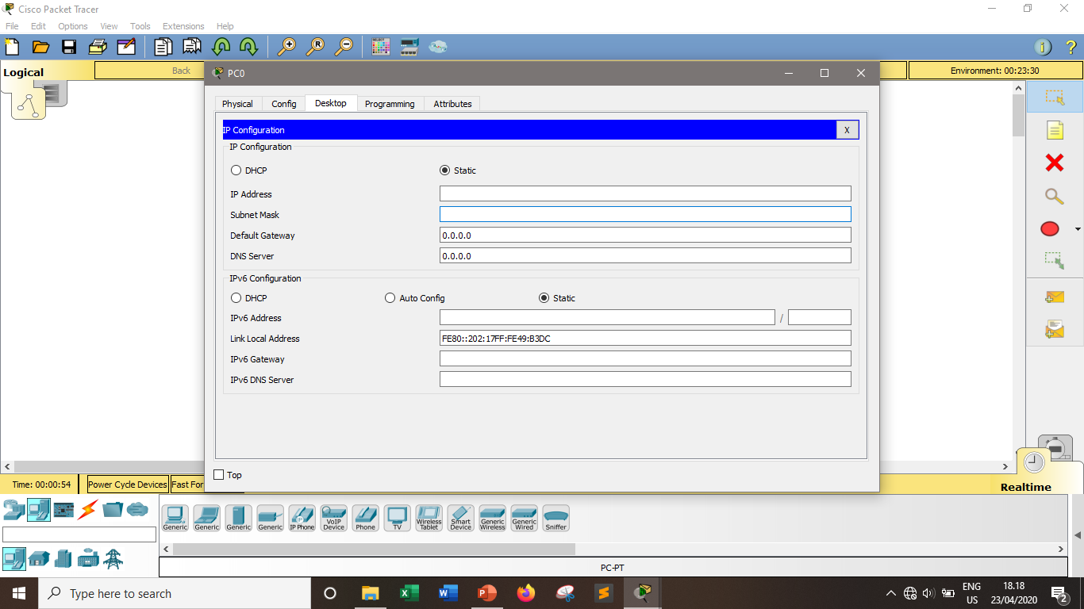

Slide 16
KELAS | SUBNET MASK OTOMATIS
A | 255.0.0.0
B | 255.255.0.0
C | 255.255.255.0

Slide 17
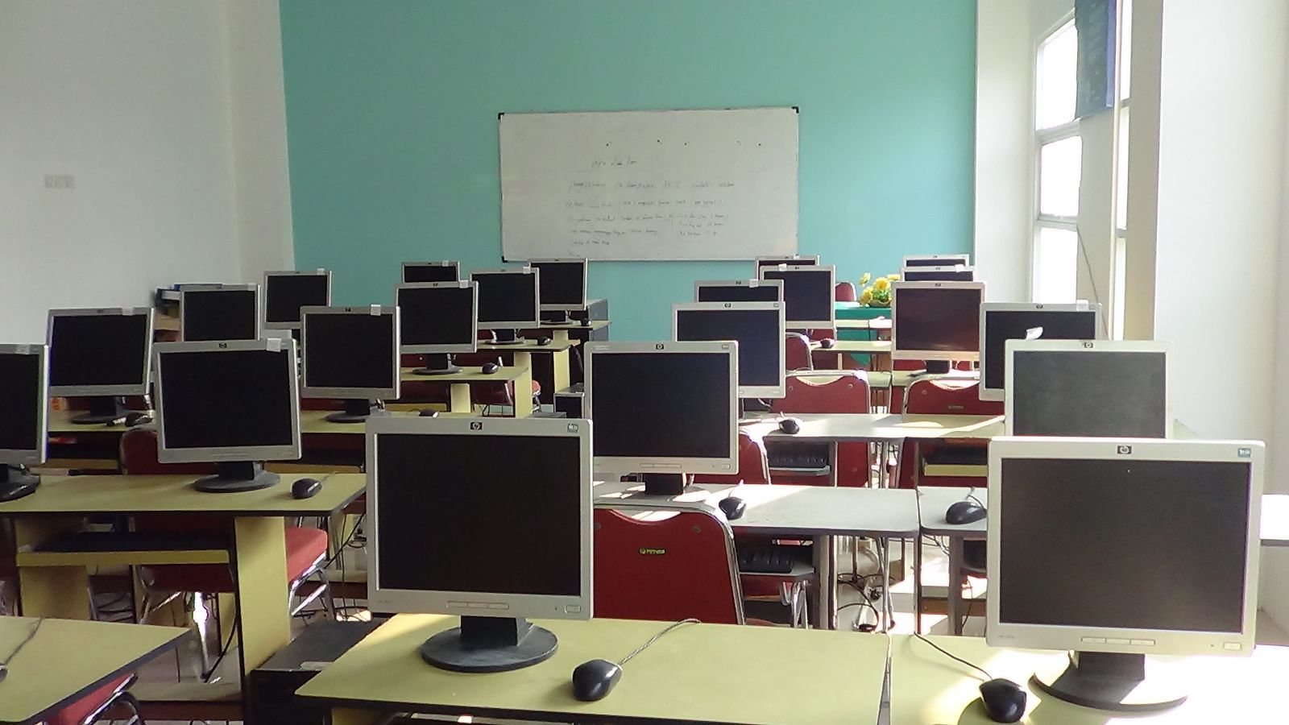
Kenapa Butuh Subnetting?
192.160.0.x
255.255.255.0
30 PC
Mubadzir

Slide 18
Kenapa Butuh Subnetting?
192.160.0.x
255.255.255.0
30 PC
254 PC

Slide 19
192.160.0.x
255.255.255.224
30 PC
32 PC

Slide 20
Tujuan Subnetting:
Efisiensi jaringan (Efisiensi IP Address)
Alasan keamanan
Membuat jaringan sehat & ideal

Slide 21
CIDR
Classes Inter-Domain Routing

Slide 22
Sistem pengganti kelas IP (A,B,C,D,E)
Kelas IP diganti karena menyisakan banyak IP yang tidak terpakai

Slide 23
IP Private dalam Sistem CIDR
RANGE IP | JUMLAH HOST | CIDR BLOCK | SUBNET MASK
10.0.0.0 – 10.255.255.255 | 16.777.216 | /8 | 255.0.0.0
17.16.0.0 – 17.31.255.255 | 1.048.576 | /12 | 255.240.0.0
192.168.0.0 – 192.168.255.255 | 65.536 | /16 | 255.255.0.0

Slide 24
Perhitungan Subnetting

Slide 25
3 jenis IP pada Subnetting
Host Address : Range IP yang bisa dipasang ke device/perangkat
Network Address : IP pertama pada subnet, merepresentasikan jaringan
Broadcast Address: IP terakhir pada subnet, untuk mengirim data secara broadcast

Slide 26
Alur Perhitungan Subnetting
Tentukan jumlah IP address (2^32 - nilai CIDR)
Tentukan subnet mask (255.255.255.256 – total IP)
Tentukan jumlah host address (IP Address total - 2)
Tentukan network address (IP Address pertama)
Tentukan broadcast address (IP Address terakhir)
Tentukan range host address (IP antara pertama & terakhir)

Slide 27
Contoh 1

Slide 28
Tentukan subnetting dari IP 192.168.0.x /29
Jumlah IP Address = 2^32 - nilai CIDR
= 2^32 - 29
= 2^3
= 8 IP Address
Subnet mask = 255.255.255.256 - 8
= 255.255.255.248

Slide 29
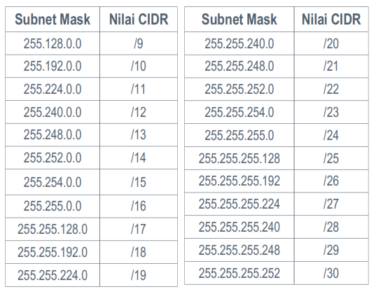

Slide 30
Host Address = Jumlah IP Address - 2
= 8 - 2
= 6

Slide 31
Network Address = IP Pertama
= 192.168.0.0
Broadcast Address = IP Terakhir
= 192.168.0.0 + (total IP Address - 1)
= 192.168.0.0 + (8 - 1)
= 192.168.0.0 + 7
= 192.168.0.7

Slide 32
Range host address = antara IP Address Pertama dan Terakhir
IP Pertama (Network) = 192.168.0.0
IP Terakhir (Broadcast) = 192.168.0.7
Range Host Address = 192.168.0.1 sd 192.168.0.6

Slide 33
Kesimpulan
Network Address = 192.168.0.0
Broadcast Address = 192.168.0.7
Range Host Address = 192.168.0.1 sd 192.168.0.6
Jumlah Host = 6
Jumlah IP Address = 8
Subnet Mask = 255.255.255.248

Slide 34
Contoh 2

Slide 35
Tentukan subnetting dari IP 172.16.3.x /24
Jumlah IP Address = 2^32 - nilai CIDR
= 2^32 - 24
= 2^8
= 256 IP Address
Subnet mask = 255.255.255.256 - 256
= 255.255.255.0

Slide 37
Host Address = Jumlah IP Address - 2
= 256 - 2
= 254

Slide 38
Network Address = IP Pertama
= 172.16.3.0
Broadcast Address = IP Terakhir
= 172.16.3.0 + (total IP Address - 1)
= 172.16.3.0 + (256 - 1)
= 172.16.3.0 + 255
= 172.16.3.255

Slide 39
Range host address = antara IP Address Pertama dan Terakhir
IP Pertama (Network) = 172.16.3.0
IP Terakhir (Broadcast) = 172.16.3.255
Range Host Address = 172.16.3.1 sd 172.16.3.254

Slide 40
Kesimpulan
Network Address = 172.16.3.0
Broadcast Address =
Range Host Address = 172.16.3.1 172.16.3.255sd 172.16.3.254
Jumlah Host = 254
Jumlah IP Address = 256
Subnet Mask = 255.255.255.0

Slide 41
Contoh 3

Slide 42
Sebuah perusahaan memiliki 500 PC. Tentukan subnetting yang sesuai jika IP yang digunakan adalah 10.2.0.x!
Cari nilai CIDR dengan IP Address >= 500, yakni /23
Jumlah IP Address = 2^32 - 23
= 2^7
= 512 IP Address

Slide 43
Subnet mask = 255.255.255.256 - Jumlah IP Address
= 255.255.255.256 - 512
= 255.255.255.0 - 256
= 255.255.254.256 - 256 (pinjam oktet sebelah kiri)
= 255.255.254.256 - 256
= 255.255.254.0

Slide 45
Host Address = Jumlah IP Address - 2
= 512 - 2
= 510
Network Address = IP Pertama
= 10.2.0.0

Slide 46
Broadcast Address = IP Terakhir
= 10.2.0.0 + (total IP Address-1)
= 10.2.0.0 + (512-1)
= 10.2.0.0 + 511 (Tidak ada IP 10.2.0.511)
= 10.2.0.256 + 255
= 10.2.0.256 + 255 (maks 256, pindah oktet)
= 10.2.1.0 + 255
= 10.2.1.255

Slide 47
Range host address = antara IP Address Pertama dan Terakhir
IP Pertama (Network) = 10.2.0.0
IP Terakhir (Broadcast) = 10.2.1.255
Range Host Address = 10.2.0.1 sd 10.2.1.254

Slide 48
Kesimpulan
Network Address = 10.2.0.0
Broadcast Address = 10.2.1.255
Range Host Address = 10.2.0.1 sd 10.2.1.254
Jumlah Host = 510
Jumlah IP Address = 512
Subnet Mask = 255.255.254.0

Slide 49
Tugas

Slide 50
Tugas
Kerjakan di kertas selembar disertai cara/perhitungan, kemudian foto atau scan & copas ke word/pdf:
Hitung Subnetting pada IP 191.234.0.x /28
Hitung Subnetting pada IP 15.127.2.x /26
Sebuah lab memiliki 100 PC, hitung subnetting yang sesuai jika IP yang digunakan adalah 200.1.0.x

Slide 51
Latihan

Slide 52
Latihan
Ubah IP Address, Subnet Mask, & Default Gateway laptop Anda menggunakan:
Command Prompt (CMD), dan
User Interface
IP Addressnya sesuai nim kalian = nim.nim.nim.nim
Default Gateway = nim.nim.nim.1
Subnetmask = /15

Slide 53
Langkah-Langkah latihan dapat dilihat di Modul 3
Screenshot tiap langkah, paste, dan jelaskan dalam word/pdf

Slide 54
Reminder
Kumpulkan Tugas rar dan Latihan rar

